Slide 1
Considerations for Designing Private and Inexpensive Smart Cities ICWMC 2020 October 18, 2020 to October 22, 2020
Jasmine DeHart¹, Corey E. Baker², Christan Grant¹
¹Department of Computer Science, University of Oklahoma, USA
²Department of Computer Science, University of Kentucky, USA
Contact: dehart.jasmine@ou.edu

Slide 2
Jasmine DeHart
Jasmine DeHart is a Doctoral Candidate in the School of Computer Science at the University of Oklahoma Gallogly College of Engineering. Jasmine obtained her BS and MS in Computer Science from Philander Smith College and the University of Oklahoma, respectively.

Slide 3
OU Data Lab
Event Extraction
Speed Labeling
Smart Cities
Fairness Forensics
Mining domain agnostic events in large data corpora
Interfaces and recommendation systems for accelerating data labeling
Mitigating cost and privacy within social networks and communities
Critical data exploration tools focused on bias and fairness
https://oudalab.github.io/

Slide 4
Network Reconnaissance Lab
Pragmatic Applications of Delay Tolerant Networks
Smart Homes and the Internet of Things
Low-Cost Smart Cities
Secure delay tolerant social network for Apple iOS devices
Opportunistic wireless communication to enable Smart Homes to flourish
Mitigating cost and privacy within social networks and communities
https://www.cs.uky.edu/~baker/research/

Slide 5
Motivation
Cost
Transforming into a smart city is expensive (e.g., between $30 Million and $40 Billion)
Privacy
Data collection and surveillance of smart city technology
https://thenounproject.com/term/smart-city/1870004/

Slide 6
How to become “Smart”?
Electric vehicle charging stations
Electric/autonomous public transportation vehicles
Connected vehicles using a smart grid
User mobile applications
Traffic signaling priority

Slide 7
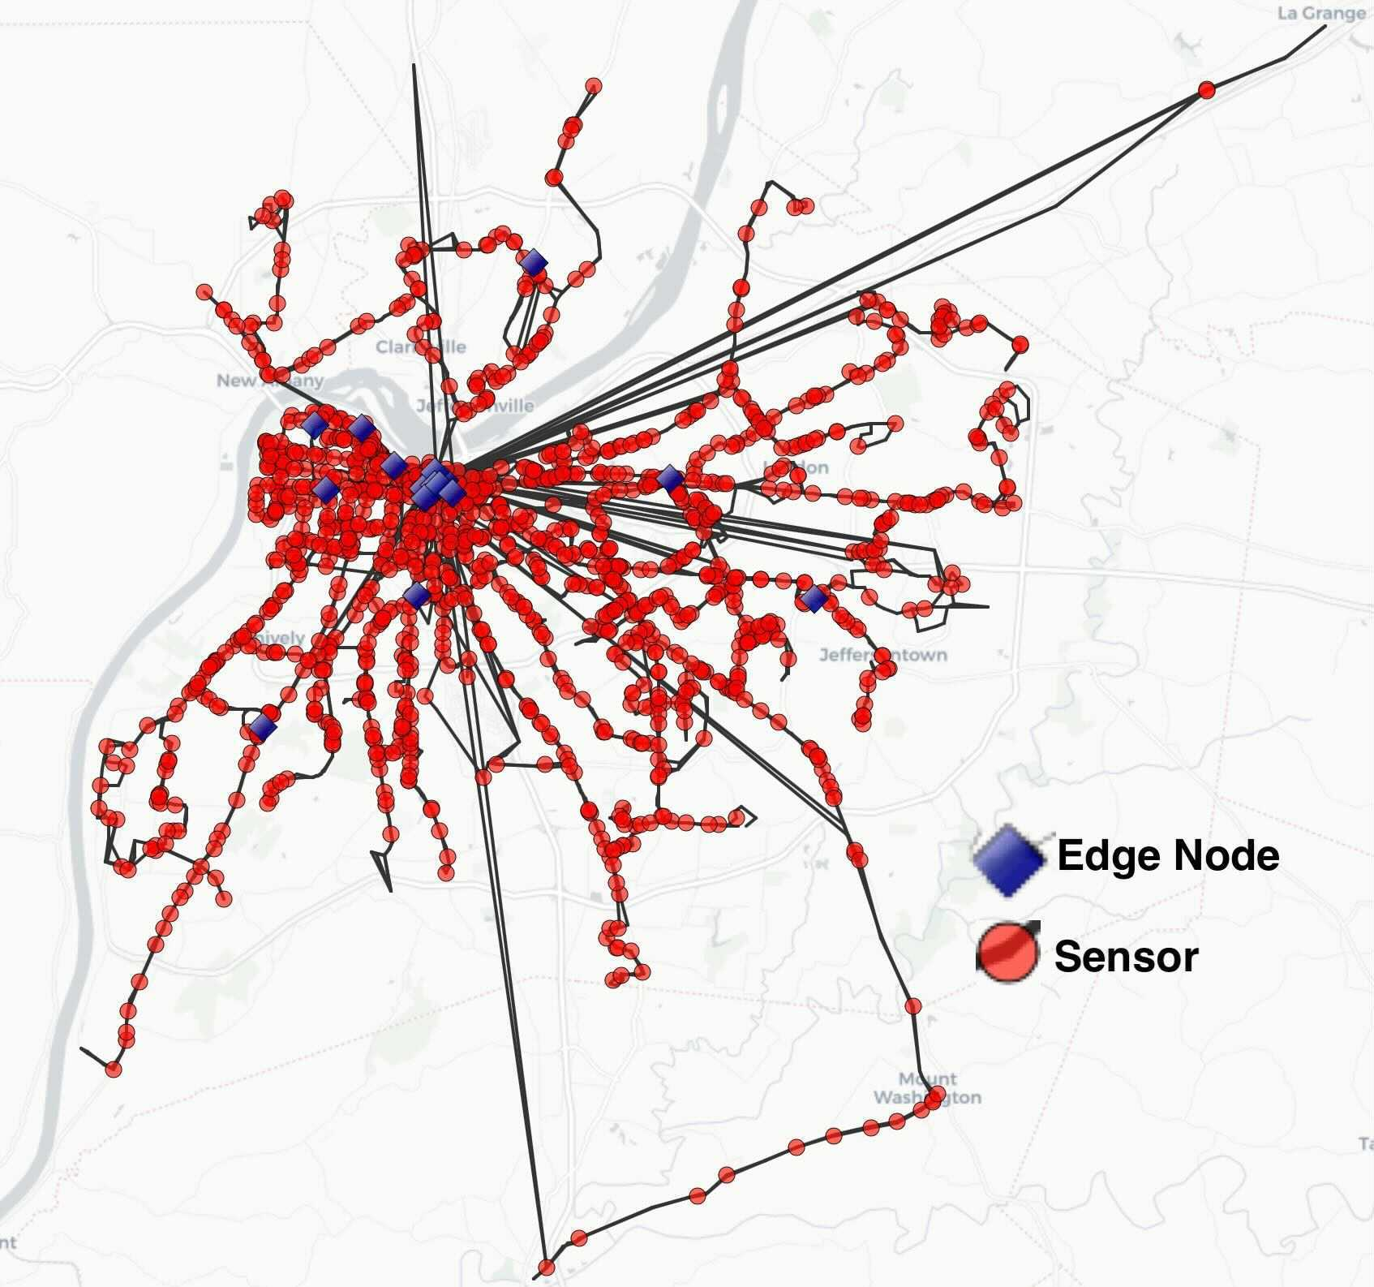
Low-Cost Smart cities
Cost of deploying and maintaining the IoT devices themselves, a significant portion of the expense is a result of providing Internet connectivity via 5G or WiFi to those devices.
Delay Tolerant Networks (DTNs) as a backbone for Smart City communication to facilitate data that does not have real-time Quality of Service (QoS) constraints.

Slide 8
Privacy- enabled Smart cities
City | Data Sharing
Columbus, OH | Poor
Austin, TX | Poor
Denver, CO | Poor
Kansas City, MO | Poor
Pittsburgh, PA | Poor
Portland, OR | Average
San Francisco, CA | Poor
Data Sharing answers (1) what information is shared, (2) who can see this data, and (3) how much information will be collected by the city.

Slide 9
Privacy- enabled Smart cities
City | Individual Privacy
Columbus, OH | Poor
Austin, TX | Poor
Denver, CO | Poor
Kansas City, MO | Average
Pittsburgh, PA | Poor
Portland, OR | Poor
San Francisco, CA | Poor
Individual Privacy is the management and protection of personally identifying information (PII).
Notes:
and management of device access control in the pipeline.
Right to be anonymous, watched?
WiFi Hotspots
Connected Devices

Slide 10
Privacy- enabled Smart cities
City | System Security
Columbus, OH | Poor
Austin, TX | Excellent
Denver, CO | Poor
Kansas City, MO | Excellent
Pittsburgh, PA | Poor
Portland, OR | Poor
San Francisco, CA | Poor
System Security addresses concerns of hacking, data breaching, cryptographic settings, and comprehensive system design.

Slide 11
Privacy- enabled Smart cities
City | Data Privacy
Columbus, OH | Poor
Austin, TX | Excellent
Denver, CO | Average
Kansas City, MO | Poor
Pittsburgh, PA | Average
Portland, OR | Average
San Francisco, CA | Poor
Data Privacy ensures all data in and data out of the Smart City system is properly protected.

Slide 12
Privacy- enabled Smart cities
City | Data Management
Columbus, OH | Poor
Austin, TX | Excellent
Denver, CO | Poor
Kansas City, MO | Poor
Pittsburgh, PA | Poor
Portland, OR | Average
San Francisco, CA | Poor
Data Management is the protocol in place to control access, data encryption and de-identification.

Slide 13
ViperLib
From this analysis, we proposed a library of privacy mitigation techniques that includes:
Visual mitigation
Various stages of deployment
Active engagement strategies
Open Source
Privacy first
😳🦹🏽‍♀️🤱🏻

Slide 14
Conclusion
Smart cities have the capability to be both private and inexpensive in deployment and for long term sustainability.
Officials and citizens should consider the high cost and privacy concerns associated
Extends from the protection of PII to anonymity and protect of minors
Use of DTNs to lower the cost and allow citizens assist in the transmission of data

Slide 15
Future work
Research potential effects of security for cyber-physical systems in real IoT deployments
Collaborate with Louisville, Kentucky to discuss future strategies
Development and deployment for ViperLib
Study African and European Smart Cities
This material is based upon work supported by the National Science Foundation under Grant No. 1952181.

Slide 16
Considerations for Designing Private and Inexpensive Smart Cities
Questions?
Jasmine DeHart, Corey E. Baker, Christan Grant
Contact: dehart.jasmine@ou.edu

