Slide 1
Towards Managing Complex Data Sharing Policies with the Min Mask Sketch
Stephen Smart & Christan Grant
IRI 2017

Slide 2
What are data sharing policies?

Slide 3
What are data sharing policies?
A sharing policy is a set of expressions that describe how, when, and what data can be accessed.
Examples:
ACL’s
IAM (Amazon Web Services)
Friend-based sharing
BitTorrent / Distributed data networks
Advertisements
Notes:
ACL’s: Describes who can access the data. (if a single file is the data set = simple. If multiple files with different policies is data set = complex)
IAM: Describes who, how, and when the data can be accessed.
Friend-based sharing: The owner of the resource can create groups of friends to define sharing.
BitTorrent: Can limit / throttle the sharing of resources.
Advertisements: Advertisers can share data through a medium according to various demographics.

Slide 4
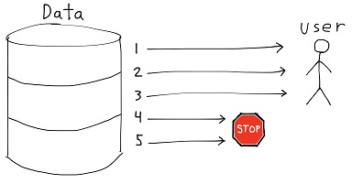
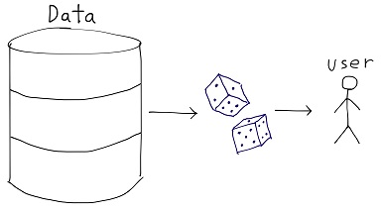
What are simple data sharing policies?
A single expression describes how to share the data.
LIMIT = 10
random() < 0.167

Slide 5
What are complex data sharing policies?
Multiple expressions describe how to share the data.
Sharing Policy ID(s) | Data
1 | Record 1
3 | Record 2
2 | Record 3
1, 3 | Record 4
1, 2, 3 | Record 5

Slide 6
Example: Weather Company X
Ship Owners
Ship
Operators
Freight
Movers
Freight Owners
Crew Management
Companies
Many
Others
sdadaInsInsurances
Companieshj
Ship Owners
Many Others
Sharing Platform
Ship Operators
Insurance
Crew
Management
Freight Movers
TIDE
RAME
Freight
Owners
Notes:
●In the maritime industry:
○ ship owners purchase ships
○The ship owners lease those ships out to ship operators to use
○Shipping companies like freight movers will contract with the operators to get freights moved.
○People who on products on these ships would like to know the ship, the freight, the destination of the ship etc.
○The ship operators can then hire management companies who then find a crew to work the ship and the docks
○Each group needs insurance companies
○There are several other players in such an ecosystem

Slide 7
Example: Health Tracker Pro

Slide 8
Example Data Set
time | heart_rate | blood_sugar | body_temp
2016-02-20 04:05:06 | 71 | 95 | 98.6
2016-02-20 04:05:09 | 72 | 96 | 98.7
2016-02-20 04:05:09 | 72 | 94 | 98.7
2016-02-21 11:14:40 | 115 | 125 | 99.3
2016-02-21 11:14:43 | 115 | 124 | 99.5
2016-02-21 11:14:46 | 116 | 124 | 99.6

Slide 9
Example Data Set with Sharing Policies
time | heart_rate | blood_sugar | body_temp | high_hr | low_bs | high_bt
2016-02-20 04:05:06 | 71 | 95 | 98.6 | 0 | 1 | 0
2016-02-20 04:05:09 | 72 | 96 | 98.7 | 0 | 1 | 0
2016-02-20 04:05:09 | 72 | 94 | 98.7 | 0 | 1 | 0
2016-02-21 11:14:40 | 115 | 125 | 99.3 | 1 | 0 | 1
2016-02-21 11:14:43 | 115 | 124 | 99.5 | 1 | 0 | 1
2016-02-21 11:14:46 | 116 | 124 | 99.6 | 1 | 0 | 1

Slide 10
How can we store this policy metadata more efficiently?

Slide 11
Probabilistic Data Structures
Sacrifice a small amount of accuracy in exchange for space efficiency.
Can answer queries about the data without needing to store the entire data set.
Examples
Bloom Filter
Count Min Sketch
+

Slide 12
Bloom Filter
Probabilistic data structure that is used to test whether an element is a member of a data set.
Uses an array of bits and a collection of hash functions.
Conceived by Burton Howard Bloom in 1970.

Slide 13
How Does it Work?
Initialization:
Bloom Filter
Notes:
g(x) = h₁(x) + i * h₂(x)
https://github.com/oudalab/mms/blob/master/cms_topn.c#L397

Slide 14
How Does it Work?
Initialization:
Set each bit in the array to 0.
Create k hash functions using technique from Kirsch et. al 2005
Bloom Filter
0 | 0 | 0 | 0 | 0 | 0 | 0 | 0 | 0 | 0 | 0 | 0 | 0 | 0 | 0

Slide 15
Bloom Filter: Inserting
Insert an element, X.
Let k = 3
Bloom Filter
0 | 0 | 0 | 0 | 0 | 0 | 0 | 0 | 0 | 0 | 0 | 0 | 0 | 0 | 0

Slide 16
Bloom Filter: Inserting
Insert an element, X.
Let k = 3
h₁(X) = 7
Bloom Filter
0 | 0 | 0 | 0 | 0 | 0 | 0 | 0 | 0 | 0 | 0 | 0 | 0 | 0 | 0

Slide 17
Bloom Filter: Inserting
Insert an element, X.
Let k = 3
h₁(X) = 7
h₂(X) = 2
Bloom Filter
0 | 0 | 0 | 0 | 0 | 0 | 0 | 0 | 0 | 0 | 0 | 0 | 0 | 0 | 0

Slide 18
Bloom Filter: Inserting
Insert an element, X.
Let k = 3
h₁(X) = 7
h₂(X) = 2
h₃(X) = 11
Bloom Filter
0 | 0 | 0 | 0 | 0 | 0 | 0 | 0 | 0 | 0 | 0 | 0 | 0 | 0 | 0

Slide 19
Bloom Filter: Inserting
Insert an element, X.
Let k = 3
h₁(X) = 7
h₂(X) = 2
h₃(X) = 11
Each hash value corresponds to an index in the array of bits.
Bloom Filter
0 | 0 | 0 | 0 | 0 | 0 | 0 | 0 | 0 | 0 | 0 | 0 | 0 | 0 | 0

Slide 20
Bloom Filter: Inserting
Insert an element, X.
Let k = 3
h₁(X) = 7
h₂(X) = 2
h₃(X) = 11
Each hash value corresponds to an index in the array of bits.
For each index calculated above, set the associated bit to 1.
Bloom Filter
0 | 0 | 0 | 0 | 0 | 0 | 0 | 0 | 0 | 0 | 0 | 0 | 0 | 0 | 0

Slide 21
Bloom Filter: Inserting
Insert an element, X.
Let k = 3
h₁(X) = 7
h₂(X) = 2
h₃(X) = 11
Each hash value corresponds to an index in the array of bits.
For each index calculated above, set the associated bit to 1.
Bloom Filter
0 | 0 | 0 | 0 | 0 | 0 | 0 | 1 | 0 | 0 | 0 | 0 | 0 | 0 | 0
7

Slide 22
Bloom Filter: Inserting
Insert an element, X.
Let k = 3
h₁(X) = 7
h₂(X) = 2
h₃(X) = 11
Each hash value corresponds to an index in the array of bits.
For each index calculated above, set the associated bit to 1.
Bloom Filter
0 | 0 | 1 | 0 | 0 | 0 | 0 | 1 | 0 | 0 | 0 | 0 | 0 | 0 | 0
2

Slide 23
Bloom Filter: Inserting
Insert an element, X.
Let k = 3
h₁(X) = 7
h₂(X) = 2
h₃(X) = 11
Each hash value corresponds to an index in the array of bits.
For each index calculated above, set the associated bit to 1.
Bloom Filter
0 | 0 | 1 | 0 | 0 | 0 | 0 | 1 | 0 | 0 | 0 | 1 | 0 | 0 | 0
11

Slide 24
Bloom Filter: Querying
Query an element, W.
Bloom Filter
0 | 0 | 1 | 0 | 0 | 0 | 0 | 1 | 0 | 0 | 0 | 1 | 0 | 0 | 0

Slide 25
Bloom Filter: Querying
Query an element, W.
Hash W using all k hash functions.
Bloom Filter
0 | 0 | 1 | 0 | 0 | 0 | 0 | 1 | 0 | 0 | 0 | 1 | 0 | 0 | 0

Slide 26
Bloom Filter: Querying
Query an element, W.
Hash W using all k hash functions.
h₁(W) = 5
h₂(W) = 2
h₃(W) = 1
Bloom Filter
0 | 0 | 1 | 0 | 0 | 0 | 0 | 1 | 0 | 0 | 0 | 1 | 0 | 0 | 0

Slide 27
Bloom Filter: Querying
Query an element, W.
Hash W using all k hash functions.
h₁(W) = 5
h₂(W) = 2
h₃(W) = 1
Bloom Filter
0 | 0 | 1 | 0 | 0 | 0 | 0 | 1 | 0 | 0 | 0 | 1 | 0 | 0 | 0
1
2
5

Slide 28
Bloom Filter: Querying
If all bits are 1, W is said to exist in the set.
If all bits are not 1, W is said to not exist in the set.
Bloom Filter
0 | 0 | 1 | 0 | 0 | 0 | 0 | 1 | 0 | 0 | 0 | 1 | 0 | 0 | 0
1
2
5

Slide 29
Bloom Filter: False Positives
Hash collisions can result in false positives.
Bloom Filter
0 | 0 | 1 | 0 | 0 | 0 | 0 | 1 | 0 | 0 | 0 | 1 | 0 | 0 | 0

Slide 30
Bloom Filter: False Positives
Hash collisions can result in false positives.
h₂(W) collided with h₂(X)
Bloom Filter
0 | 0 | 1 | 0 | 0 | 0 | 0 | 1 | 0 | 0 | 0 | 1 | 0 | 0 | 0
2

Slide 31
Bloom Filter: False Positives
Hash collisions can result in false positives.
h₂(W) collided with h₂(X)
If the result of all k hash functions collided with any other element, all the bits would be 1, even though W is not an element in the data set.
Bloom Filter
0 | 0 | 1 | 0 | 0 | 0 | 0 | 1 | 0 | 0 | 0 | 1 | 0 | 0 | 0
2

Slide 32
Bloom Filter: False Negatives are Not Possible
If an element exists in the data set, the Bloom Filter query will always return true.
Bloom Filter
0 | 0 | 1 | 0 | 0 | 0 | 0 | 1 | 0 | 0 | 0 | 1 | 0 | 0 | 0

Slide 33
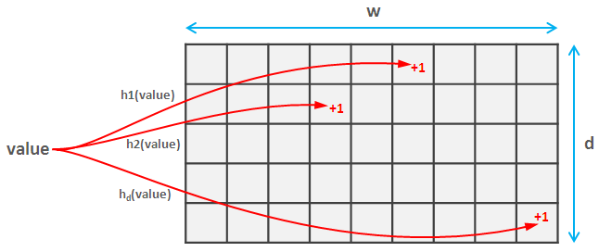
Count-min Sketch
Like a Bloom Filter but uses an array of counters instead of an array of bits.
Used to determine an element’s frequency within a data set.
Cormode et al. (2005)

Slide 34
Count-min Sketch: Inserting
When inserting an element, the element’s primary key is hashed using all d hash functions.
The counter value at each index is then incremented.

Slide 35
Count-min Sketch: Querying
When querying an element, the element’s primary key is hashed using all d hash functions.
The minimum counter value at each index is returned as the estimated frequency for the element.

Slide 36
Count-min Sketch: Frequency Estimates
The frequency can be overestimated due to hash collisions.
The frequency cannot be underestimated.

Slide 37
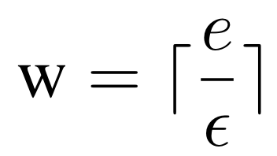
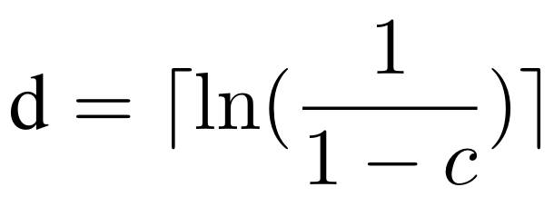
Count-min Sketch: Parameters
Sketch is sized according to the desired quality.
The frequency estimate is bounded by an additive factor of ϵ with probability c.
ϵ and c are chosen by the developer.

Slide 38
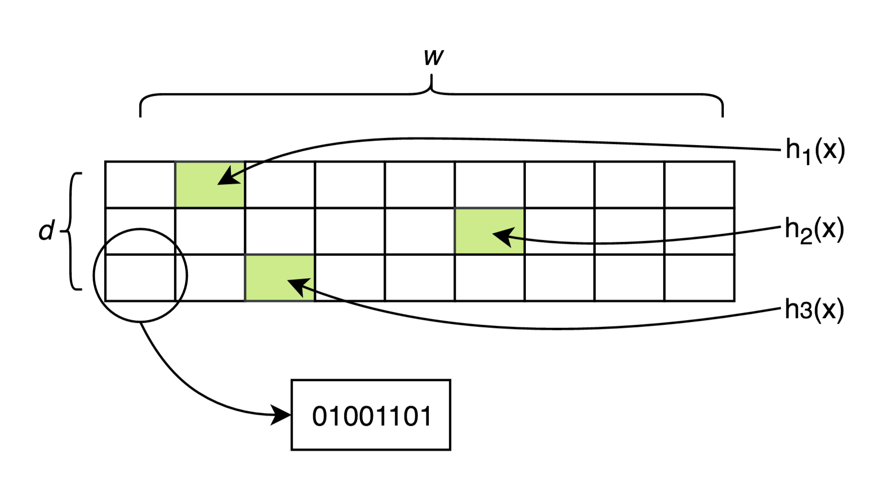
Min Mask Sketch
Like a Count-min Sketch but uses an array of bit strings instead of an array of counters.
Used to determine an element’s sharing policy information within a data set.
This paper.

Slide 39
What Does the Bit String Represent?
Each position in the bit string represents a possible expression to evaluate in order to share or restrict data.
Expression 1 | heart_rate > 114
... | ...
Expression 4 | random() < 0.167
... | ...
Expression 8 | LIMIT = 10
00101001

Slide 40
What Does the Bit String Represent?
Each position in the bit string represents a possible expression to evaluate in order to share or restrict data.
If a bit at a particular position is set to 1, that expression is active
Expression 1 | heart_rate > 114
... | ...
Expression 4 | random() < 0.167
... | ...
Expression 8 | LIMIT = 10
00101001
Expression 4 is active
Notes:
A policy may expire, so a expression that was true may no longer be true.

Slide 41
What Does the Bit String Represent?
Each position in the bit string represents a possible expression to evaluate in order to share or restrict data.
If a bit at a particular position is set to 1, that expression is active.
If a bit at a particular position is set to 0, that expression is inactive.
Expression 1 | heart_rate > 114
... | ...
Expression 4 | random() < 0.167
... | ...
Expression 8 | LIMIT = 10
00101001
Expression 8 is inactive
Expression 4 is active

Slide 42
Min Mask Sketch: Inserting
The new element is hashed based on its primary key (x) using the d different hash functions. mms[h_{i}(primary_key)] |= policy_string

Slide 43
Min Mask Sketch: Inserting
The new element is hashed based on its primary key (x) using the d different hash functions. mms[h_{i}(primary_key)] |= policy_string
00101001
New element bit string
Notes:
We insert the policy element that corresponds to the new element’s primary key
mms.add(primarky_key, policy_string)

Slide 44
Min Mask Sketch: Inserting
The new element is hashed based on its primary key (x) using the d different hash functions. mms[h_{i}(primary_key)] |= policy_string
00101001
New element bit string
OR
00000001
Existing bit string within sketch

Slide 45
Min Mask Sketch: Inserting
The new element is hashed based on its primary key (x) using the d different hash functions. mms[h_{i}(primary_key)] |= policy_string
00101001
New element bit string
OR
00000001
Existing bit string within sketch
=
00101001
Resulting bit string within sketch

Slide 46
Min Mask Sketch: Querying
An element is hashed based on its primary key (x) using the d different hash functions.
h₁(x):
00101001
h₂(x):
10101101
h₃(x):
00100001
Notes:
BF check for element in set
CMS check for element frequency
MMS retrieves the element's policy string

Slide 47
Min Mask Sketch: Querying
An element is hashed based on its primary key (x) using the d different hash functions.
The bit string with the minimum number of 1’s (active expressions) is returned as the estimated sharing policy bit string.
h₁(x):
00101001
h₂(x):
10101101
h₃(x):
00100001

Slide 48
Min Mask Sketch: Querying
An element is hashed based on its primary key (x) using the d different hash functions.
The bit string with the minimum number of 1’s (active expressions) is returned as the estimated sharing policy bit string.
h₁(x):
00101001
10101101
00100001
h₂(x):
h₃(x):
00100001

Slide 49
Implementation
PostgreSQL version 9.6.
Min Mask Sketch extension written in C.
Extension contains the following components:

Slide 50
Implementation
PostgreSQL version 9.6.
Min Mask Sketch extension written in C.
Extension contains the following components:
Definition of the Min Mask Sketch data type.

Slide 51
Implementation
PostgreSQL version 9.6.
Min Mask Sketch extension written in C.
Extension contains the following components:
Definition of the Min Mask Sketch data type.
Functions to create a new Min Mask Sketch object.

Slide 52
Implementation
PostgreSQL version 9.6.
Min Mask Sketch extension written in C.
Extension contains the following components:
Definition of the Min Mask Sketch data type.
Functions to create a new Min Mask Sketch object.
Functions to insert an element into the Min Mask Sketch.

Slide 53
Implementation
PostgreSQL version 9.6.
Min Mask Sketch extension written in C.
Extension contains the following components:
Definition of the Min Mask Sketch data type.
Functions to create a new Min Mask Sketch object.
Functions to insert an element into the Min Mask Sketch.
Functions to retrieve the bit string for a given element in the Min Mask Sketch.

Slide 54
Implementation
PostgreSQL version 9.6.
Min Mask Sketch extension written in C.
Extension contains the following components:
Definition of the Min Mask Sketch data type.
Functions to create a new Min Mask Sketch object.
Functions to insert an element into the Min Mask Sketch.
Functions to retrieve the bit string for a given element in the Min Mask Sketch.
https://github.com/oudalab/mms

Slide 55
Workflow
PostgreSQL user-facing functions
C / PostgreSQL wrapper functions
C functions
Min Mask Sketch

Slide 56
Usage: Creating an Empty Min Mask Sketch
CREATE EXTENSION mms;
CREATE TABLE example ( example_sketch mms );
INSERT INTO example VALUES(mms());

Slide 57
Usage: Inserting an Element
UPDATE example SET example_sketch = mms_add(example_sketch, "abc"::text, 6);
Element Primary Key
00000110

Slide 58
Usage: Querying the Min Mask Sketch
SELECT mms_get_mask(example_sketch, "abc"::text) FROM example;

Slide 59
Benefit
Consider the Health Tracker Pro example:

Slide 60
Benefit
Consider the Health Tracker Pro example:
Each record takes 16 bytes to store.

Slide 61
Benefit
Consider the Health Tracker Pro example:
Each record takes 16 bytes to store.
The simple approach of using 3 separate columns to store the sharing policy metadata would add an additional 3 bytes to each record.

Slide 62
Benefit
Consider the Health Tracker Pro example:
Each record takes 16 bytes to store.
The simple approach of using 3 separate columns to store the sharing policy metadata would add an additional 3 bytes to each record.
Using c = 95% and ϵ = 0.001, the Min Mask Sketch would require 8.154 KB to store the policy metadata.

Slide 63
Benefit
Consider the Health Tracker Pro example:
Each record takes 16 bytes to store.
The simple approach of using 3 separate columns to store the sharing policy metadata would add an additional 3 bytes to each record.
Using c = 95% and ϵ = 0.001, the Min Mask Sketch would require 8.154 KB to store the policy metadata.
For 1 GB of data, The simple approach would require 187.5 MB.

Slide 64
Benefit
Consider the Health Tracker Pro example:
Each record takes 16 bytes to store.
The simple approach of using 3 separate columns to store the sharing policy metadata would add an additional 3 bytes to each record.
Using c = 95% and ϵ = 0.001, the Min Mask Sketch would require 8.154 KB to store the policy metadata.
For 1 GB of data, The simple approach would require 187.5 MB.
This results in the Min Mask Sketch providing a 187.49 MB reduction in storage cost for this example.

Slide 65
Downside
Could over-share data due to the probabilistic nature of the data structure.
Notes:
Extra 1’s doesn’t necessarily mean oversharing. If you already have a set of condition that are anded together, you still have to evaluate the policies. A false positive is when you accidently get a one that ends up evaluating to true and you had all zeros to start with.
If each data item is sensitive, it should be encrypted and the key must be retrieved via a policy lookuip. This is a practice in a large tech organization.

Slide 66
Downside
Could over-share data due to the probabilistic nature of the data structure.
Cannot deactivate an expression (move from a 1 to a 0).
Notes:
Extra 1’s doesn’t necessarily mean oversharing. If you already have a set of condition that are anded together, you still have to evaluate the policies. A false positive is when you accidently get a one that ends up evaluating to true and you had all zeros to start with.
If each data item is sensitive, it should be encrypted and the key must be retrieved via a policy lookup. This is a practice in a large tech organization.

Slide 67
Downside
Could over-share data due to the probabilistic nature of the data structure.
Cannot deactivate an expression (move from a 1 to a 0).
When policies cluster together, the mms can become inefficient.
Notes:
Extra 1’s doesn’t necessarily mean oversharing. If you already have a set of condition that are anded together, you still have to evaluate the policies. A false positive is when you accidently get a one that ends up evaluating to true and you had all zeros to start with.
If each data item is sensitive, it should be encrypted and the key must be retrieved via a policy lookup. This is a practice in a large tech organization.

Slide 68
Future Directions
Expanding the Min Mask Sketch to store types of metadata other than sharing policy information.
Rigorous study of the performance characteristics of the Min Mask Sketch.
Comparison with other solutions to handling sharing policies.

Slide 69
References
Bloom, Burton H. "Space/time trade-offs in hash coding with allowable errors." Communications of the ACM 13.7 (1970): 422-426.
Cormode, Graham, and Shan Muthukrishnan. "An improved data stream summary: the count-min sketch and its applications." Journal of Algorithms 55.1 (2005): 58-75.
Kirsch, Adam, and Michael D. Mitzenmacher. "Building a better bloom filter." (2005).

Slide 70
Images Used
http://cliparting.com/wp-content/uploads/2016/10/Young-person-clipart-kid.gif
https://maxcdn.icons8.com/Share/icon/Data//database1600.png
http://cliparting.com/wp-content/uploads/2017/01/Free-clip-art-doctor-clipartfest.jpeg
https://upload.wikimedia.org/wikipedia/commons/thumb/3/36/Two_red_dice_01.svg/2000px-Two_red_dice_01.svg.png
https://en.wikipedia.org/wiki/Bloom_filter#/media/File:Bloom_filter.svg
https://i.stack.imgur.com/uh3NR.png
https://raw.githubusercontent.com/docker-library/docs/01c12653951b2fe592c1f93a13b4e289ada0e3a1/postgres/logo.png

Slide 71
Thank You!

Slide 72
Policy Log Approach
What if the data sharing policies tend to cluster together?

Slide 73
Policy Log Approach
What if the data sharing policies tend to cluster together?
time | heart_rate | blood_sugar | body_temp | high_hr | low_bs | hide_bt
2016-02-20 04:05:06 | 71 | 95 | 98.6 | 0 | 1 | 0
2016-02-20 04:05:09 | 72 | 96 | 98.7 | 0 | 1 | 0
2016-02-20 04:05:09 | 72 | 94 | 98.7 | 0 | 1 | 0
2016-02-21 11:14:40 | 115 | 125 | 99.3 | 1 | 0 | 1
2016-02-21 11:14:43 | 115 | 124 | 99.5 | 1 | 0 | 1
2016-02-21 11:14:46 | 116 | 124 | 99.6 | 1 | 0 | 1

Slide 74
Policy Log Approach
A log of the data sharing policies and when they change would be a better approach.
This approach requires more space as a function of the policy changes.
key | high_hr | low_bs | high_bt
2016-02-20 04:05:06 | 0 | 1 | 0
2016-02-21 11:14:40 | 1 | 0 | 1

Slide 75
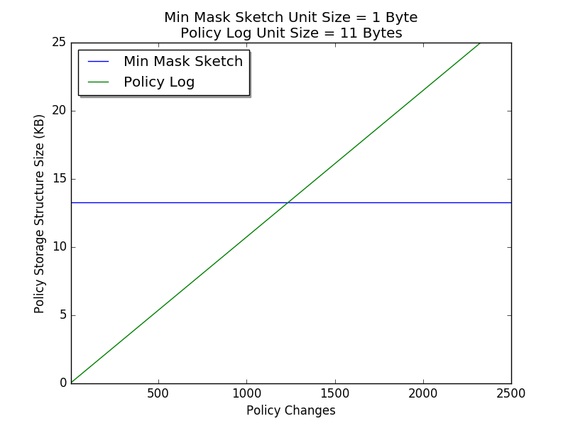
Min Mask Sketch vs. Policy Log
In the context of the Health Tracker Pro example.
Min Mask Sketch parameters:
ϵ = 0.001
c = 99%

